Slide 1

Nike Product Review Topic Modeling
Insights from Amazon’s Clothing, Shoes & Jewelry Reviews
Ryan W
Notes:
Hi everyone, my name is Ryan, and today I’ll be presenting a topic modeling analysis of Nike product reviews from Amazon’s Clothing, Shoes, and Jewelry category. The goal is to understand what customers talk about most and translate those topics into actionable marketing insights.

Slide 2
Objective
Identify reviews related to Nike products from a large Amazon dataset
Use topic modeling to uncover the main themes in customer reviews
Interpret those themes to generate actionable marketing & product insights
Notes:
The objective of this project is threefold:
First, identify customer conversations specifically about Nike products.
Second, use unsupervised topic modeling to uncover the main themes in their reviews.
And third, interpret these themes to generate insights that Nike could use for marketing, product messaging, or product development.

Slide 3
Dataset Overview
Dataset Overview
Amazon Clothing/Shoes/Jewelry review dataset
Extracted Nike reviews using ASIN metadata
Preprocessed text:
  Lowercasing
  Tokenization
  Stopword removal (including domain-specific words)
  Lemmatization
Final dataset: Nike-only reviews used for topic modeling
Notes:
The dataset contains millions of Amazon clothing and footwear reviews.
From this dataset, I filtered for entries that reference Nike by checking the metadata and ASINs, which resulted in a focused subset of Nike-related reviews.
All analysis from this point forward is based solely on that filtered subset.

Slide 4
Modeling Approach: LDA Topic Modeling
Built dictionary & corpus from cleaned review text
Tuned number of topics — selected 4 based on coherence + interpretability
Trained LDA model (Gensim)
Assigned each review to its most probable topic
Visualized results using pyLDAvis and word clouds
Notes:
After cleaning and preparing the review text, I built a document-term matrix and trained an LDA topic model using four topics — a number chosen because it produced clear, interpretable themes.
LDA assigns each review to a topic based on word patterns, letting us see what customers naturally discuss without any labels

Slide 5
Topics Overview
Top Words per Topic
Topic 0 — Fit & Sizing
great, love, fit, good, comfortable, wear, look, buy, foot, color, nice, sock, run, perfect, get
Topic 1 — Comfort & Wearability
small, shirt, large, gym, short, bag, big, workout, school, pant, hat, pink, grandson, run, soccer
Topic 2 — Style & Appearance
run, sole, belt, heel, mile, leather, use, feel, pain, running, training, lace, toe, start, free
Topic 3 — Durability & Build Quality
return, watch, time, send, pay, amazon, seller, receive, come, buy, know, get, shipping, think, fake
Notes:
Here are the top words for each topic.
We can already see how different themes emerge — one topic is centered on fit and sizing, another on comfort and wearability, a third on style and appearance, and a fourth focused on durability & build quality.

Slide 6
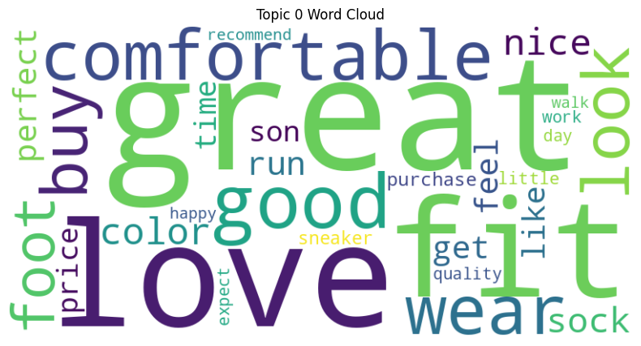
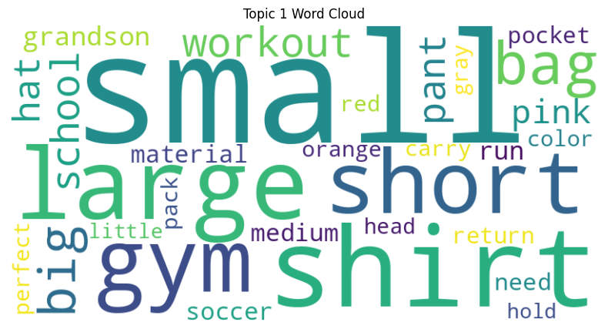
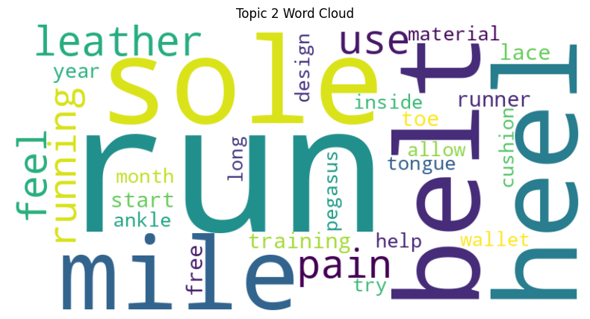
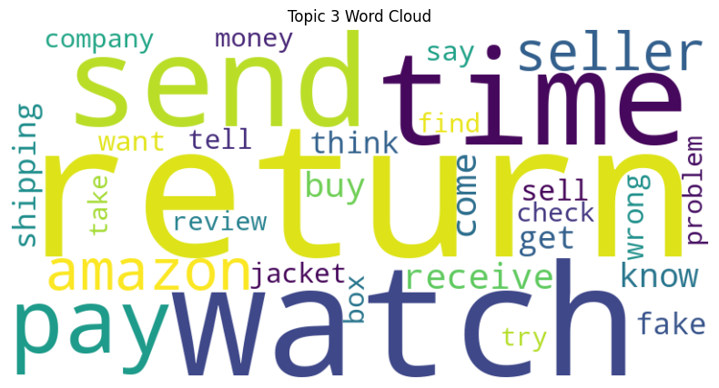
Notes:
These word clouds help visualize which terms dominate each topic.
For example, sizing-related words show up heavily in Topic 0, while words like ‘great,’ ‘love,’ and ‘fit’ dominate the sizing topic.
These visuals make it easy to compare how the topics differ.

Slide 7
Topic Insights (Cluster Summaries & ASIN Examples)
Topic 0 — Fit & Sizing
Reviews highlight cushioning, support, and all-day comfort.
Common ASINs: running shoes, casual sneakers
Topic 1 — Comfort & Wearability
Discussions focus on material life, sole wear, and long-term durability.
Common ASINs: older running models, budget-tier shoes
Topic 2 — Style & Appearance
Customers comment on look, colorways, and outfit matching.
Common ASINs: fashion sneakers, lifestyle lines
Topic 3 — Durability & Build Quality
Many mention inconsistent sizing and returns.
Common ASINs: athletic shoes, apparel
Notes:
After assigning each review to a topic, I inspected several representative reviews and their corresponding ASINs to understand what the model was picking up.
Here’s a short summary of each theme:
Topic 0: Fit & Sizing
Customers talk about cushioning, support, and how comfortable the shoes feel all day. This includes models like running and casual sneakers.
Topic 1: Comfort & Wearability
This topic captures conversations about long-term wear, material quality, or issues like soles wearing down too fast.
Topic 2: Style & Appearance
These reviews emphasize look, colorways, fashion appeal, and matching outfits.
Topic 3: Durability & Build Quality
Many reviews describe sizing inconsistencies, running small or large, and the need to size up or down. This commonly appears for athletic shoes and apparel.
Together, these topics represent the four major types of conversations customers consistently have about Nike products.

Slide 8
Marketing & Product Recommendations
Highlight comfort features — top positive theme
Address durability complaints — opportunity for product improvement
Leverage fashion appeal — strong potential for style-focused campaigns
Improve sizing guidance — reduce returns & customer frustration
Notes:
Based on these themes, here are some actionable insights:
1. Push Comfort Messaging
Nike can emphasize cushioning technology and all-day wear in marketing campaigns, since comfort is the strongest positive topic.
2. Address Durability Concerns
Some Nike models receive repeated complaints about wear-and-tear. Highlighting durability improvements could improve sentiment.
3. Lean Into Style Trends
Fashion-oriented reviews reinforce that style is a major purchase driver — strong opportunity for influencer partnerships or seasonal color drops.
4. Fix Sizing Guidance
Nike should provide clearer fit recommendations on product pages, as sizing confusion is a major friction point.
Overall, these findings provide a clearer understanding of what customers care about most and where Nike can focus messaging or product improvements.

Slide 9
Thanks for Listening
Notes:
In summary, topic modeling revealed four key themes in Nike reviews — comfort, durability, style, and sizing issues. These insights can guide clearer marketing messages and targeted product improvements. Thanks for listening.

